Slide 1
INDIA – AI HACKATHON
AI Ignite 2024
TEAM AI WARRIORS

Slide 2
Use Case Title:
Multilingual Translation Tool
Use Case Details:
To convert Spanish, German, Chinese, French and Tamil language functional documents (FD) into English (Vice Versa). Moreover, these documents can be converted into various formats, such as DOC and PDF.
Benefit:
Currently, the Dedalus care team is receiving documents in Spanish. Before proceeding with development activities, they are using DeepL or Google Translate to convert them into English. Moreover, if we need to convert a large volume of documents, we must purchase a license for the DeepL tool. However, with our new Multilingual Support Tool, we can convert documents from Spanish, German, Chinese, French and Tamil into English (Vice Versa) without needing the DeepL tool. Additionally, it supports conversion into various formats, such as DOC and PDF.

Slide 3
Overview:
This project is a Multilingual Translation Tool built using Python (Flask) on the back-end and HTML, CSS, and JavaScript on the front-end. It allows users to translate text and documents (.docx) into different languages. It uses Google Translate API for text translation and handles document translation with custom logic for parsing Word documents.
Prerequisites:
Python 3.x
pip (Python package manager)
Flask (web framework)
Googletrans (for translation Google Translate API wrapper)
python-docx (for manipulating .docx files)
Pillow (for image processing in case images are embedded in the Word document)c

Slide 4
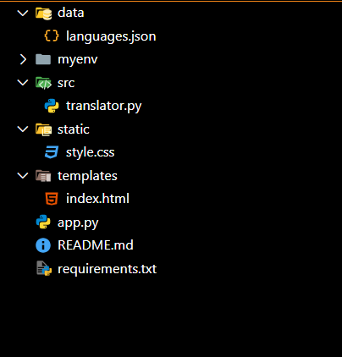
Project Structure:
multilingual-translation/
├── app.py # Main Flask application
├── static/ # Static assets (e.g., images, CSS, JS files)
│ └── styles.css # Custom styles
├── templates/ # HTML templates
│ └── index.html # Main frontend page
├── data/ # Folder for language data and configurations
│ └── languages.json # JSON file containing language codes and names
├── src/ #folder for python files
│ └── translator.py #contains all the python functions used in backend
├── requirements.txt #contains all the names of installed libraries
└── README.md # Project documentation (this file)

Slide 5
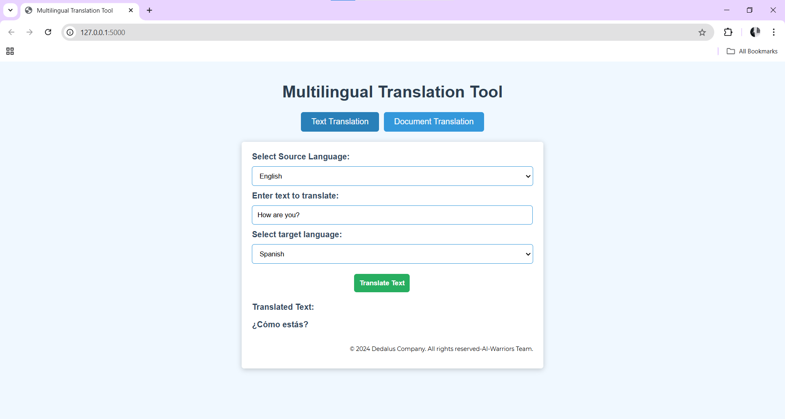
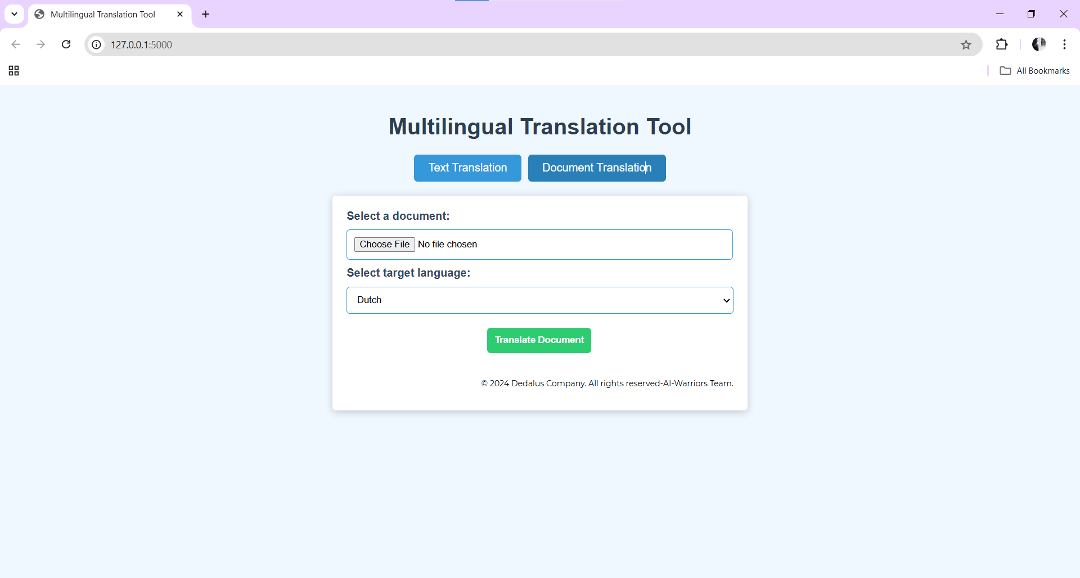
UI for the Text Translation
When any text is entered in the input area, the source language is detected automatically, and the Detected Language name is show under the Source language Dropdown.
After the text is translated, it is displayed under the Translated Text area.
UI for the Document Translation
When a document is uploaded and translated, it displays a link, which when clicked, downloads the translated document.

Slide 6
Upcoming Enhancements:
Image text translation
PDF translation implementation
PDF formatting
Conclusion:
This multilingual translation tool provides an easy-to-use web interface for translating text and Word documents. It integrates with the Google Translate API and Flask backend, while the front-end is developed with HTML, CSS, and JavaScript for dynamic interaction. This tool can be expanded to support more file formats and improve language detection and translation accuracy

Slide 7
Thank You!

